Slide 1
Non-equilibrium Folding Dynamics as an Evolutionary Basis for E. Coli 5'-UTR Codon Bias
Zhuoran Qiao
09 .12 .2018

Slide 2
Outline
Introduction: Codon bias in prokaryotes
Methodology development
Algorithm Procedure
Repartition of RNA secondary structure emsemble
Recombination& Folding pathway identification
Results
Kinetic heterogeneity during co-transcriptional folding
Transcription- ribosome binding coupling dictates mRNA level variation among synomyous sequences
Future Plan
A Kinetic model for coupled translation initiation
Quantitative species-wide investigation on codon usage selection pressure

Slide 3
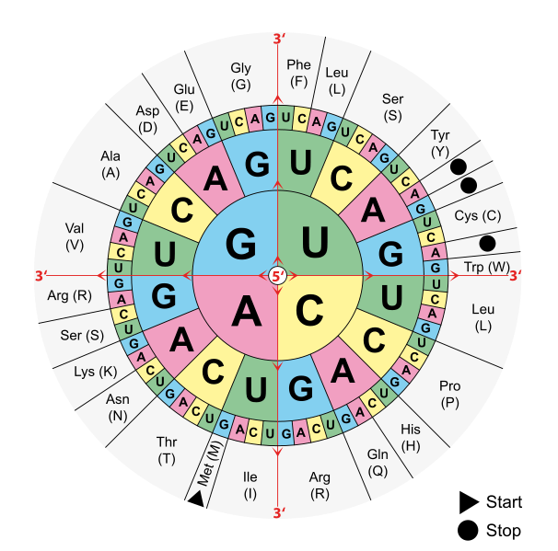
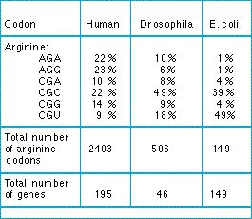
Overview: Codon bias in prokaryotes
Synonymous codons, biased frequency
5’
3’
AUG
5’ Untranslated region (5’-UTR)
More rare codons compared to genome wide usage
Evolutionarily conserved
No consensus physical mechanism has been proposed.
Genome wide bias

Slide 4
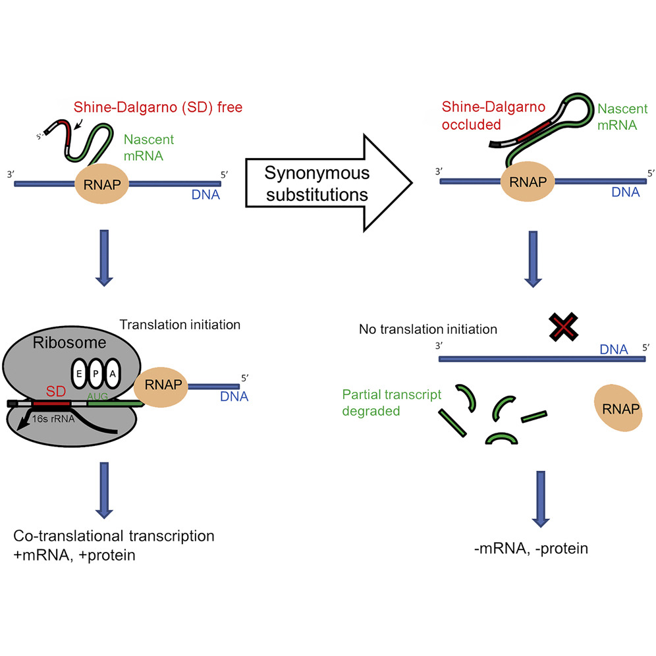
Synonymous mutations modulate expression level
Transient occlusion of the S-D sequence results in premature termination, which is responsible for mRNA level reduction.
The underlying physical mechanism is still unclear.

Slide 5
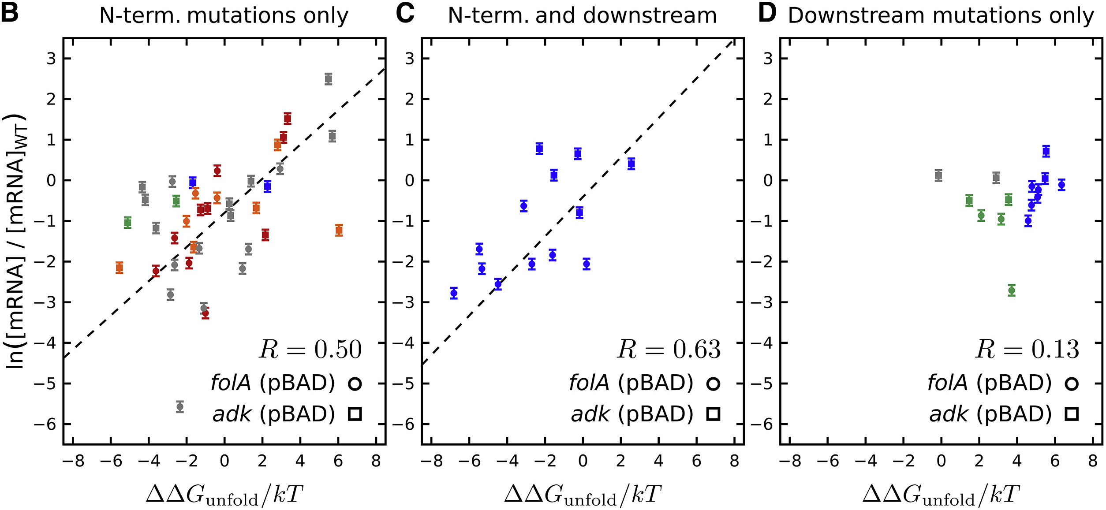
Equilibrium thermodynamics are insufficient to explain 5'-UTR codon bias in E. Coli
Only moderate correlation between local unfolding free energy & mRNA level
Unable to capture down-stream mutation effects

Slide 6
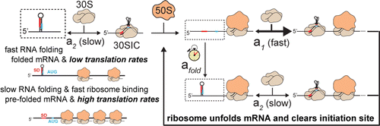
The central dogma is away from equilibrium
Similar local folding free energy
1000x translation initiation rate
Folding kinetic dependence of translation initiation:
Insight from an artifical promoter system
Beyond the simple Markov model?

Slide 7
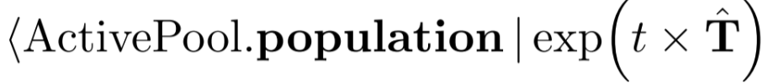
Modeling kilobase level co-transcriptional folding kinetics
Elongation
RNAP
RNAP
t→t+dt
Folding configuration space
Recombination
Integrate Master Equation
Population Selection
…
…
…
Active pool (t)
Active pool (t+dt)

Slide 8
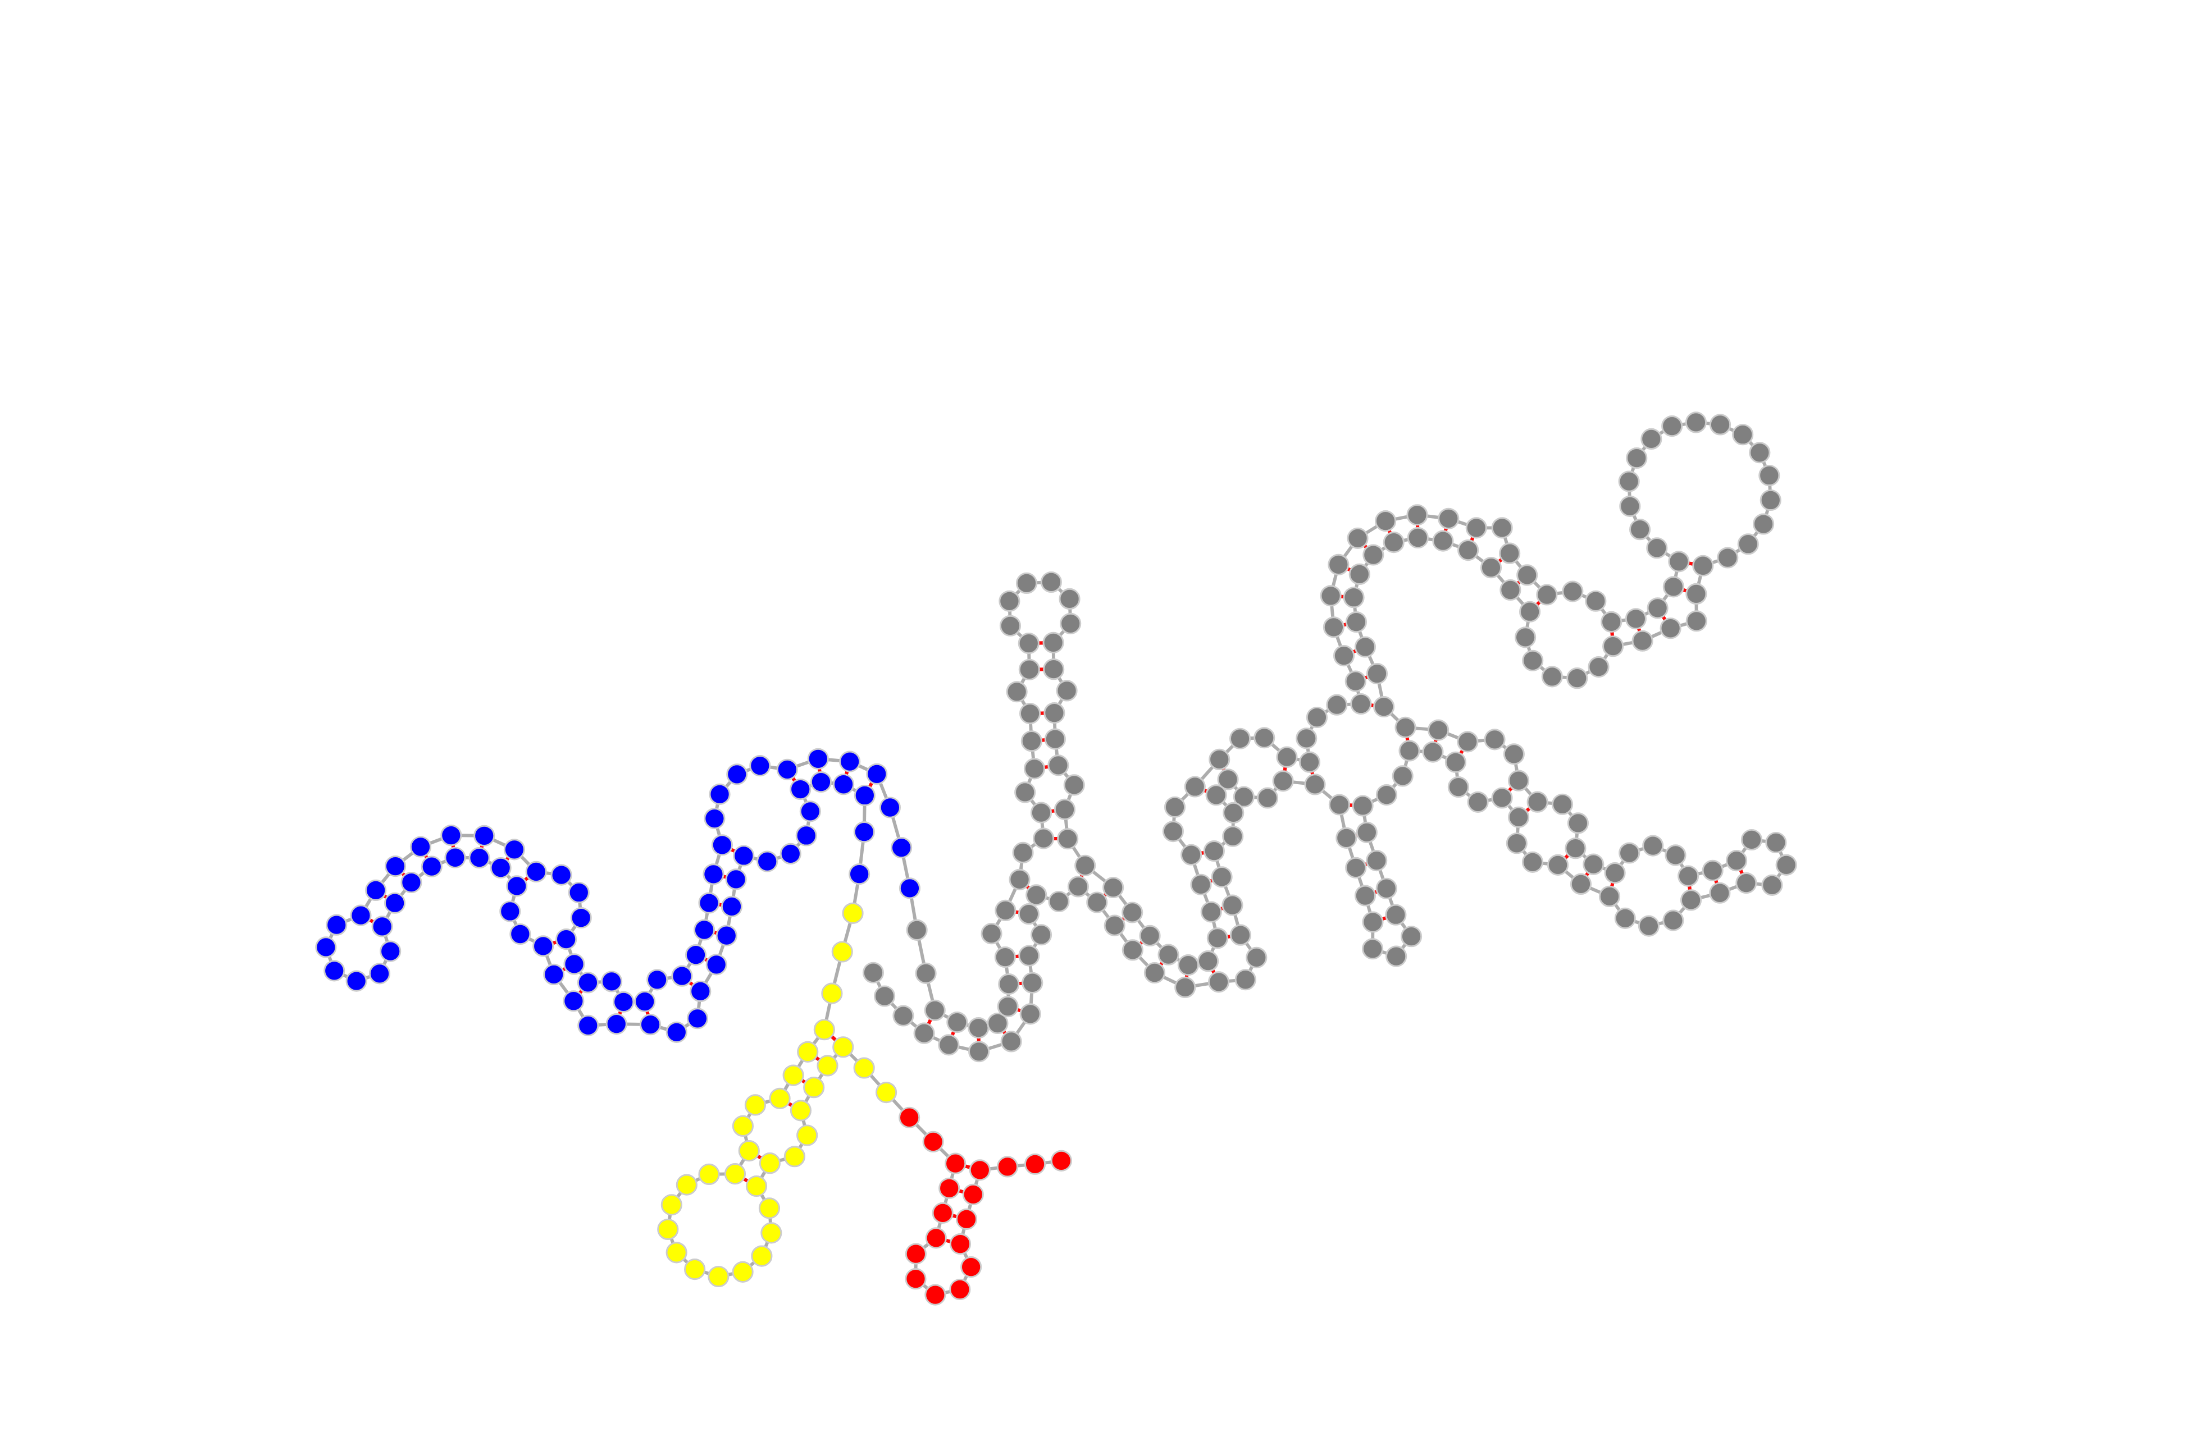
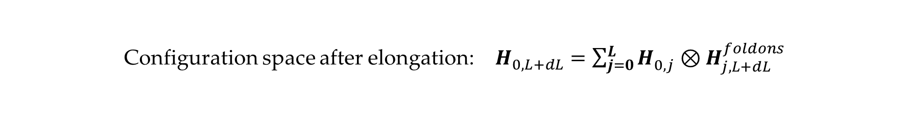
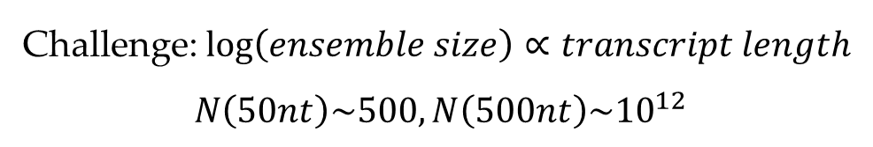
Recombination: repartition of the RNA structure ensemble
Challenge: $\log\left(ensemble size\right)∝transcript length$
$$N\left(50nt\right)\sim 500, N\left(500nt\right)\sim {10}^{12}$$
Coarse-graining the free energy landscape:
All populated RNA secondary structures
↓
Linkage of locally sub-optimal structural domains (foldons)
$$|\left.D_{A,B}^{i}\right\rangle =\left.|D_{A,i_{1}}^{foldon}\right\rangle \left.|D_{i_{1},i_{2}}^{foldon}\right\rangle \left.|D_{i_{2},i_{3}}^{foldon}\right\rangle \left.|D_{i_{4},B}^{foldon}\right\rangle$$
Configuration space after elongation: $H_{0,L+dL}^{}=\sum_{j=0}^{L}{H_{0,j}^{}⊗H_{j,L+dL}^{foldons}}$
Following this ansatz, representative structure sets within the configuration space can be calculated iteratively.
j - Possible domain boundary positions

Slide 9
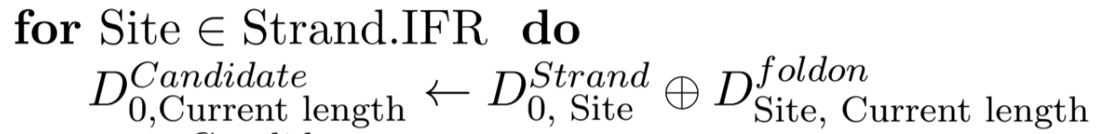
Probability distribution propagation
For every folding domain boundary within the old strand, generate child structures
Child strands with the exact parental structure (no internal rearrangement) will also inherit the population of their parent by a Boltzmann distribution:
Reconstruct the transition matrix:
Then propagate

Slide 10
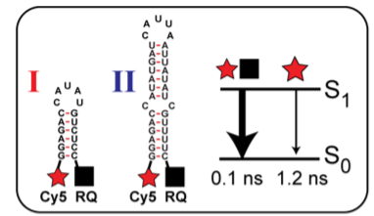
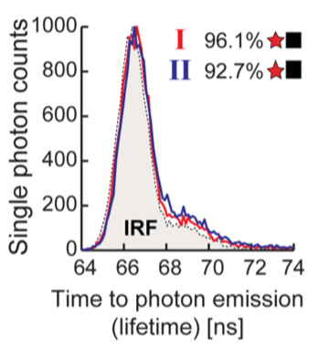
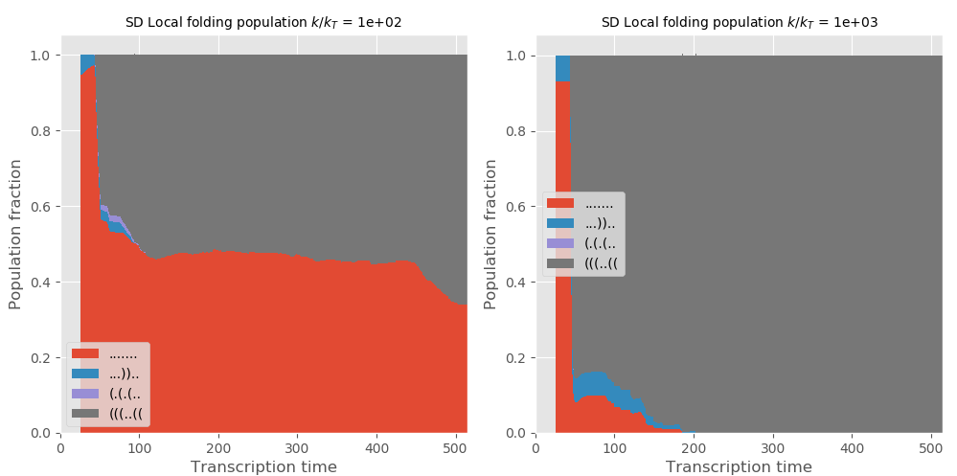
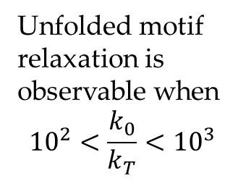
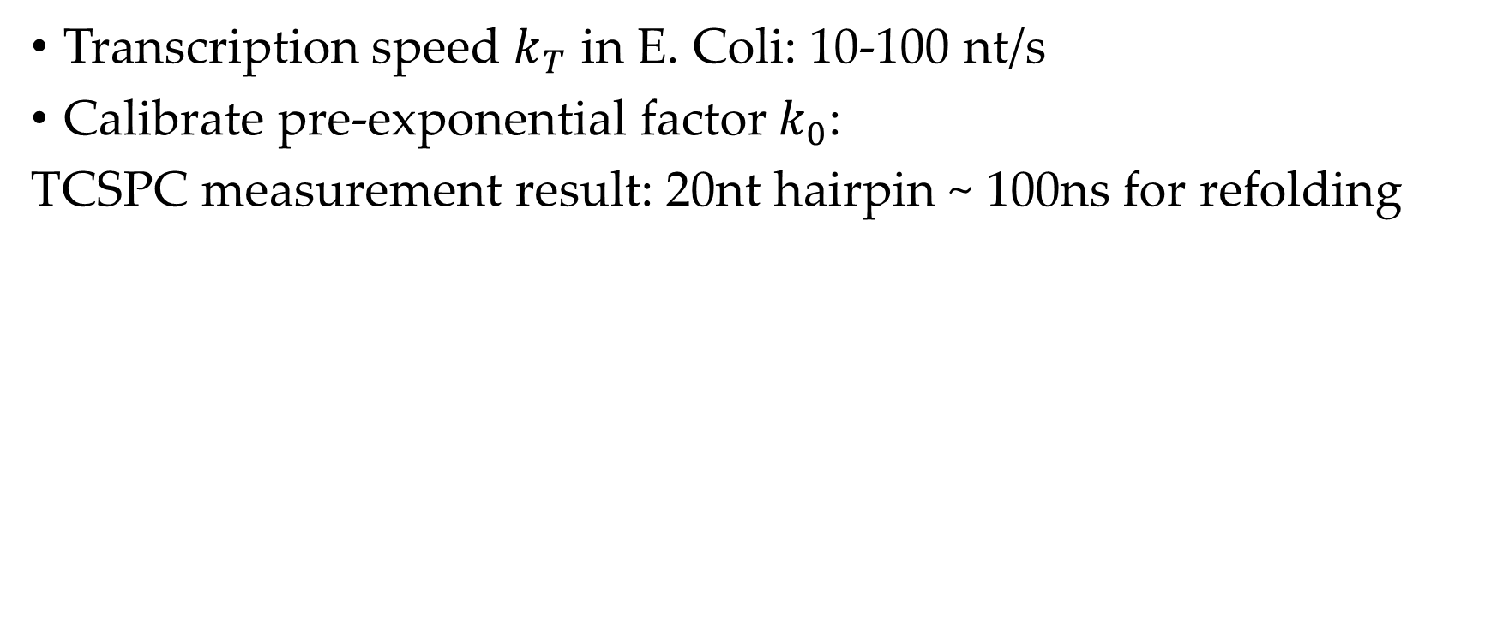
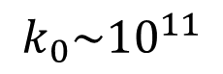
Mapping to Physiological Conditions
Transcription speed $k_{T}$ in E. Coli: 10-100 nt/s
Calibrate pre-exponential factor$k_{0}$:
TCSPC measurement result: 20nt hairpin ~ 100ns for refolding
Map to our model
Unfolded motif relaxation is observable when
$${10}^{2}<\frac{k_{0}}{k_{T}}<{10}^{3}$$
$$k_{0}\sim {10}^{11}$$

Slide 11
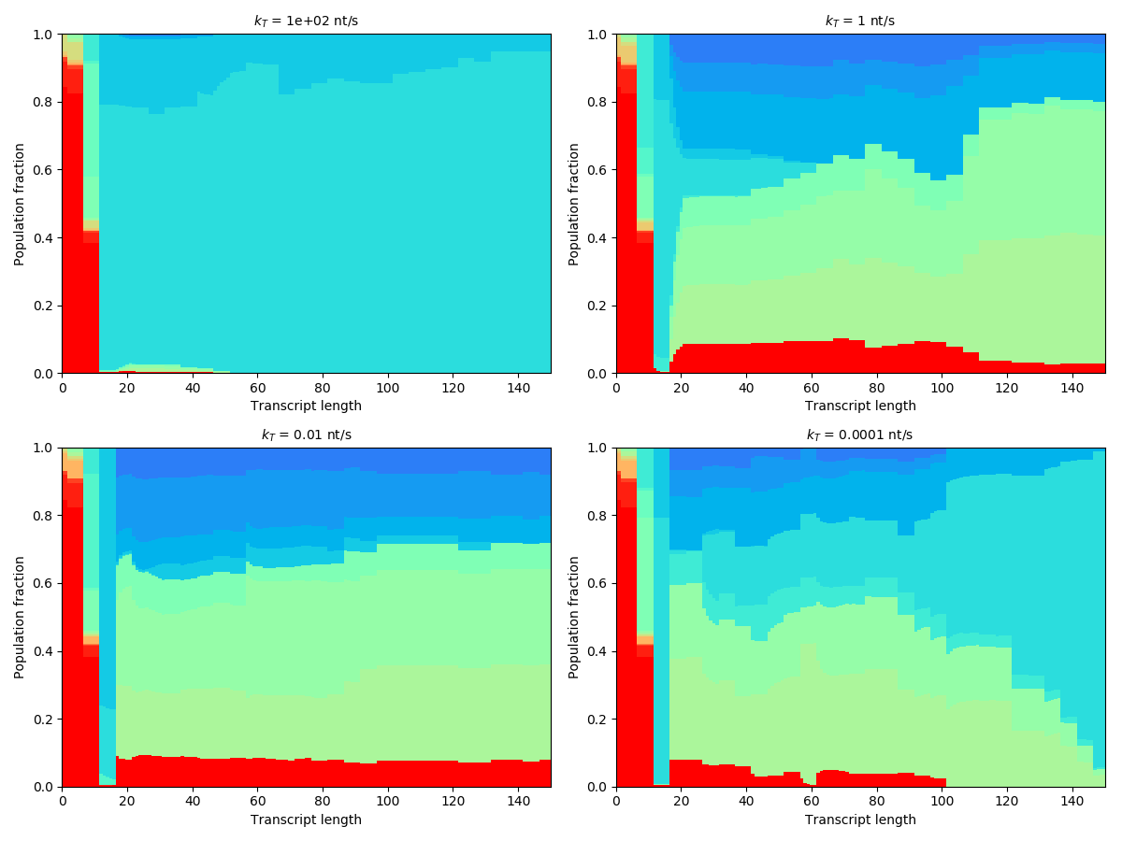
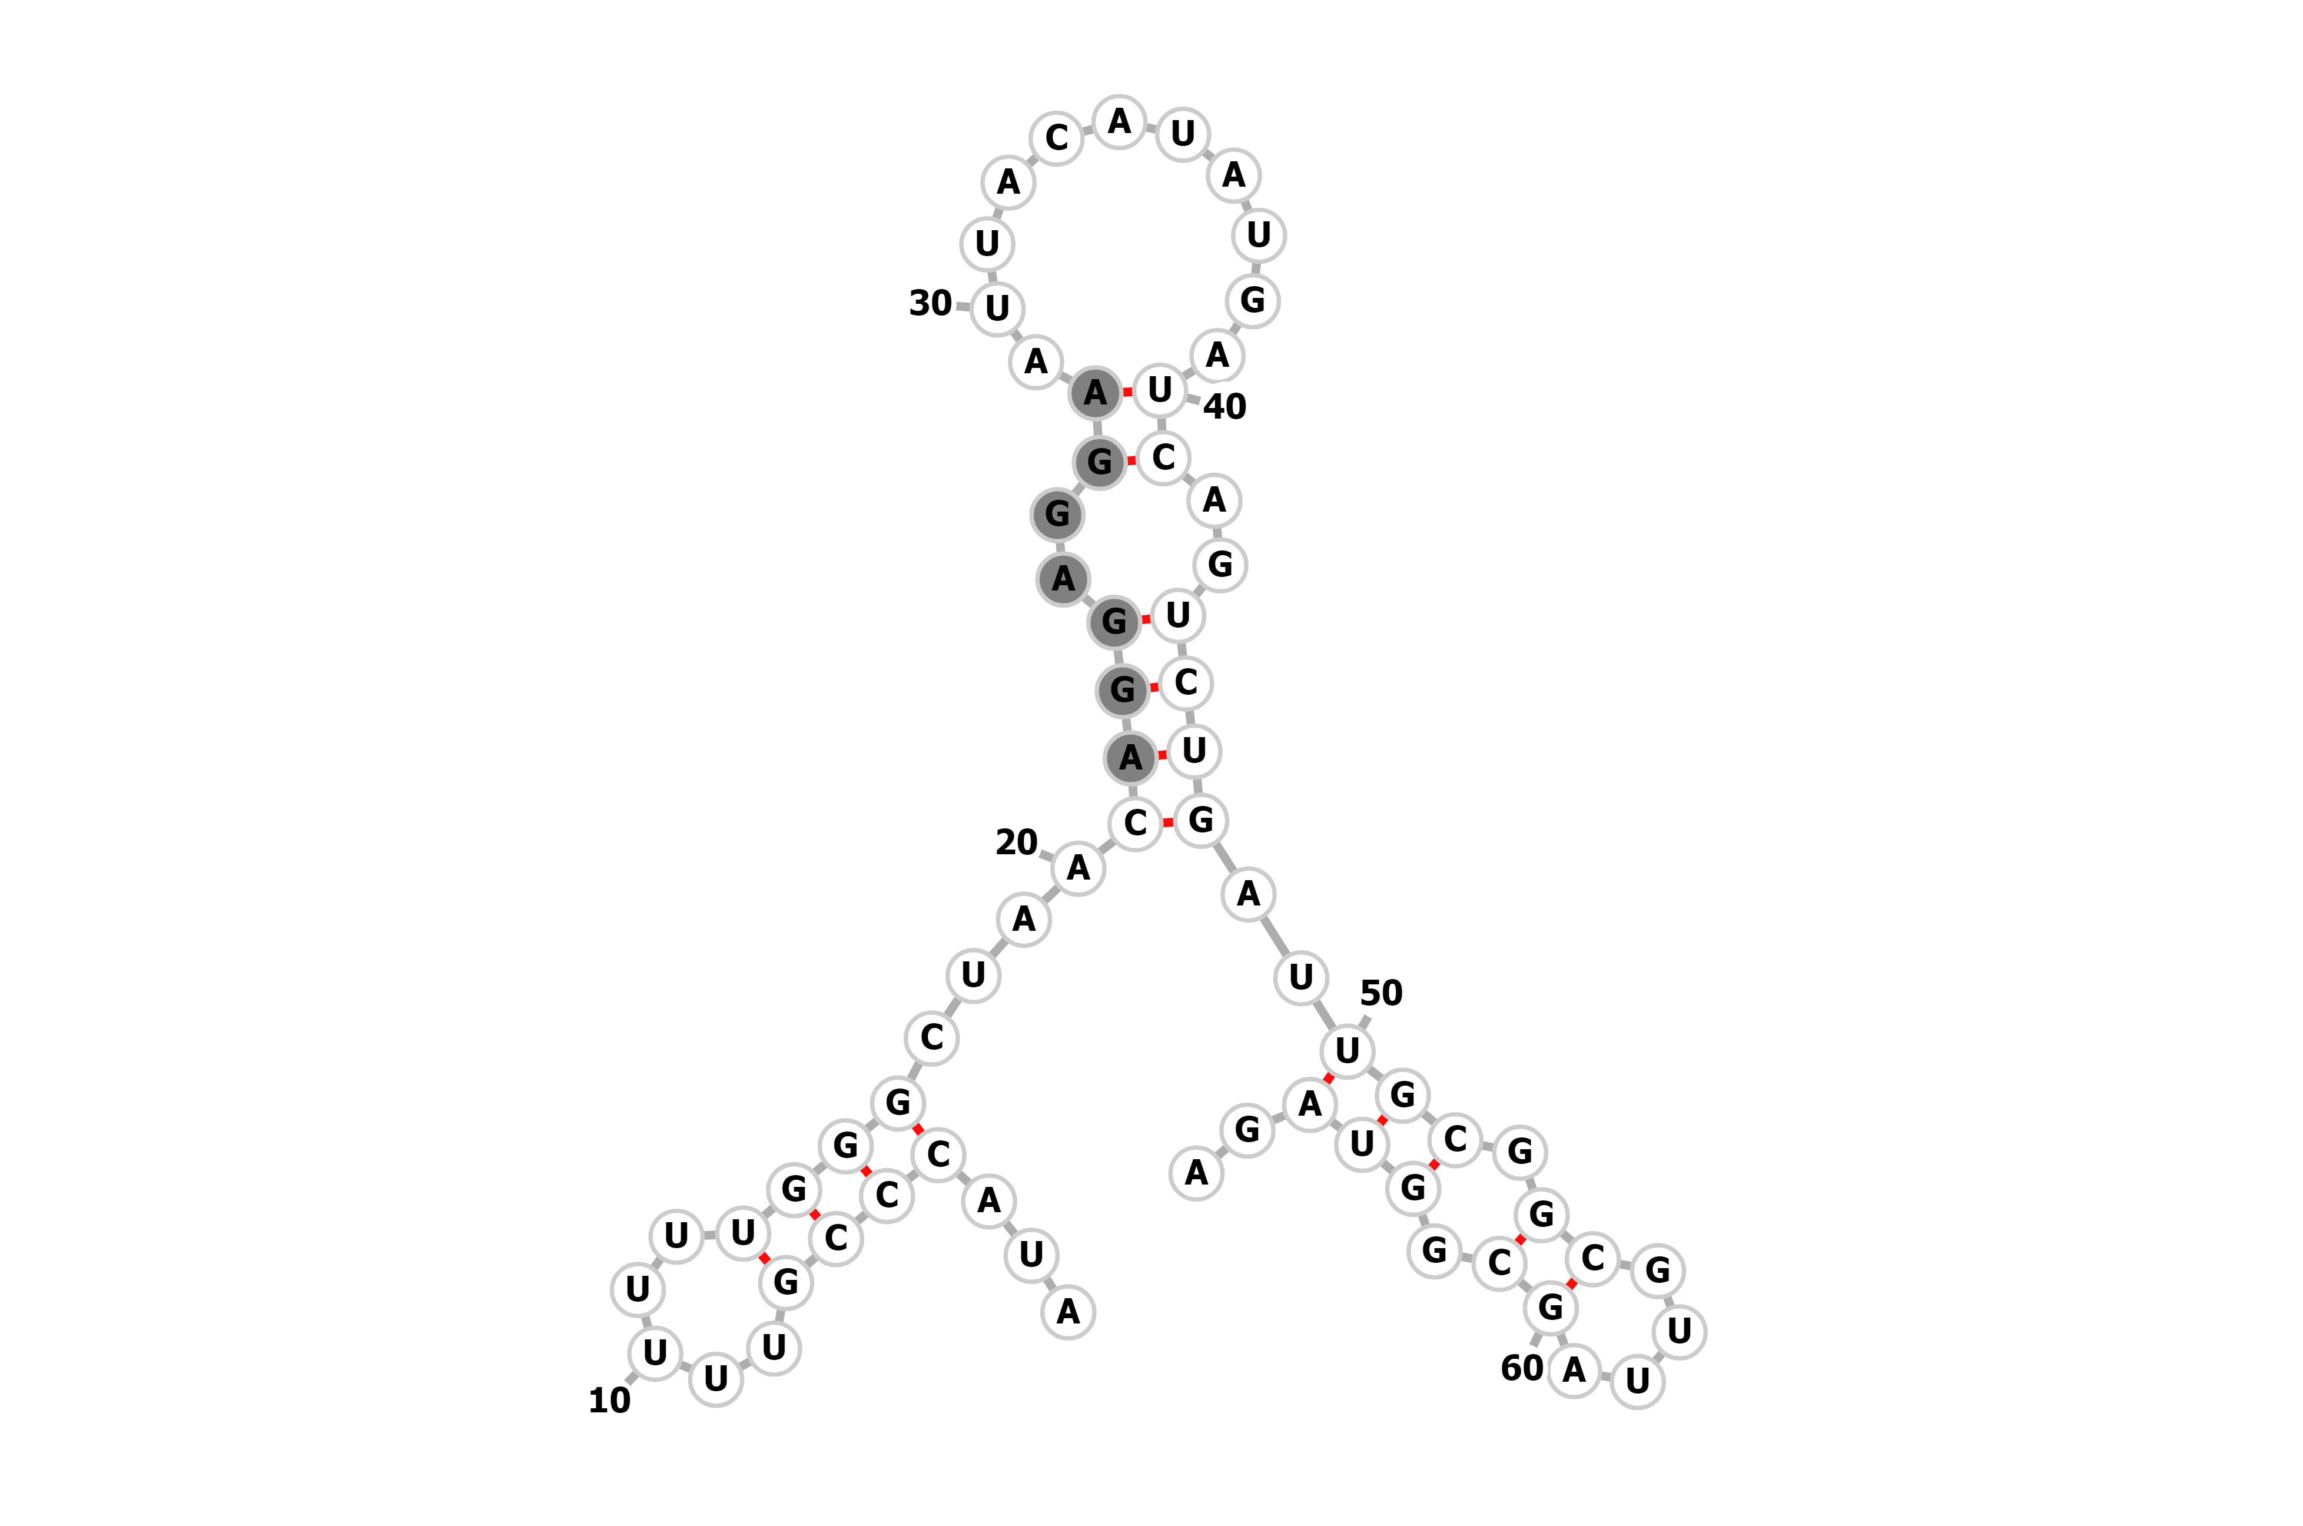
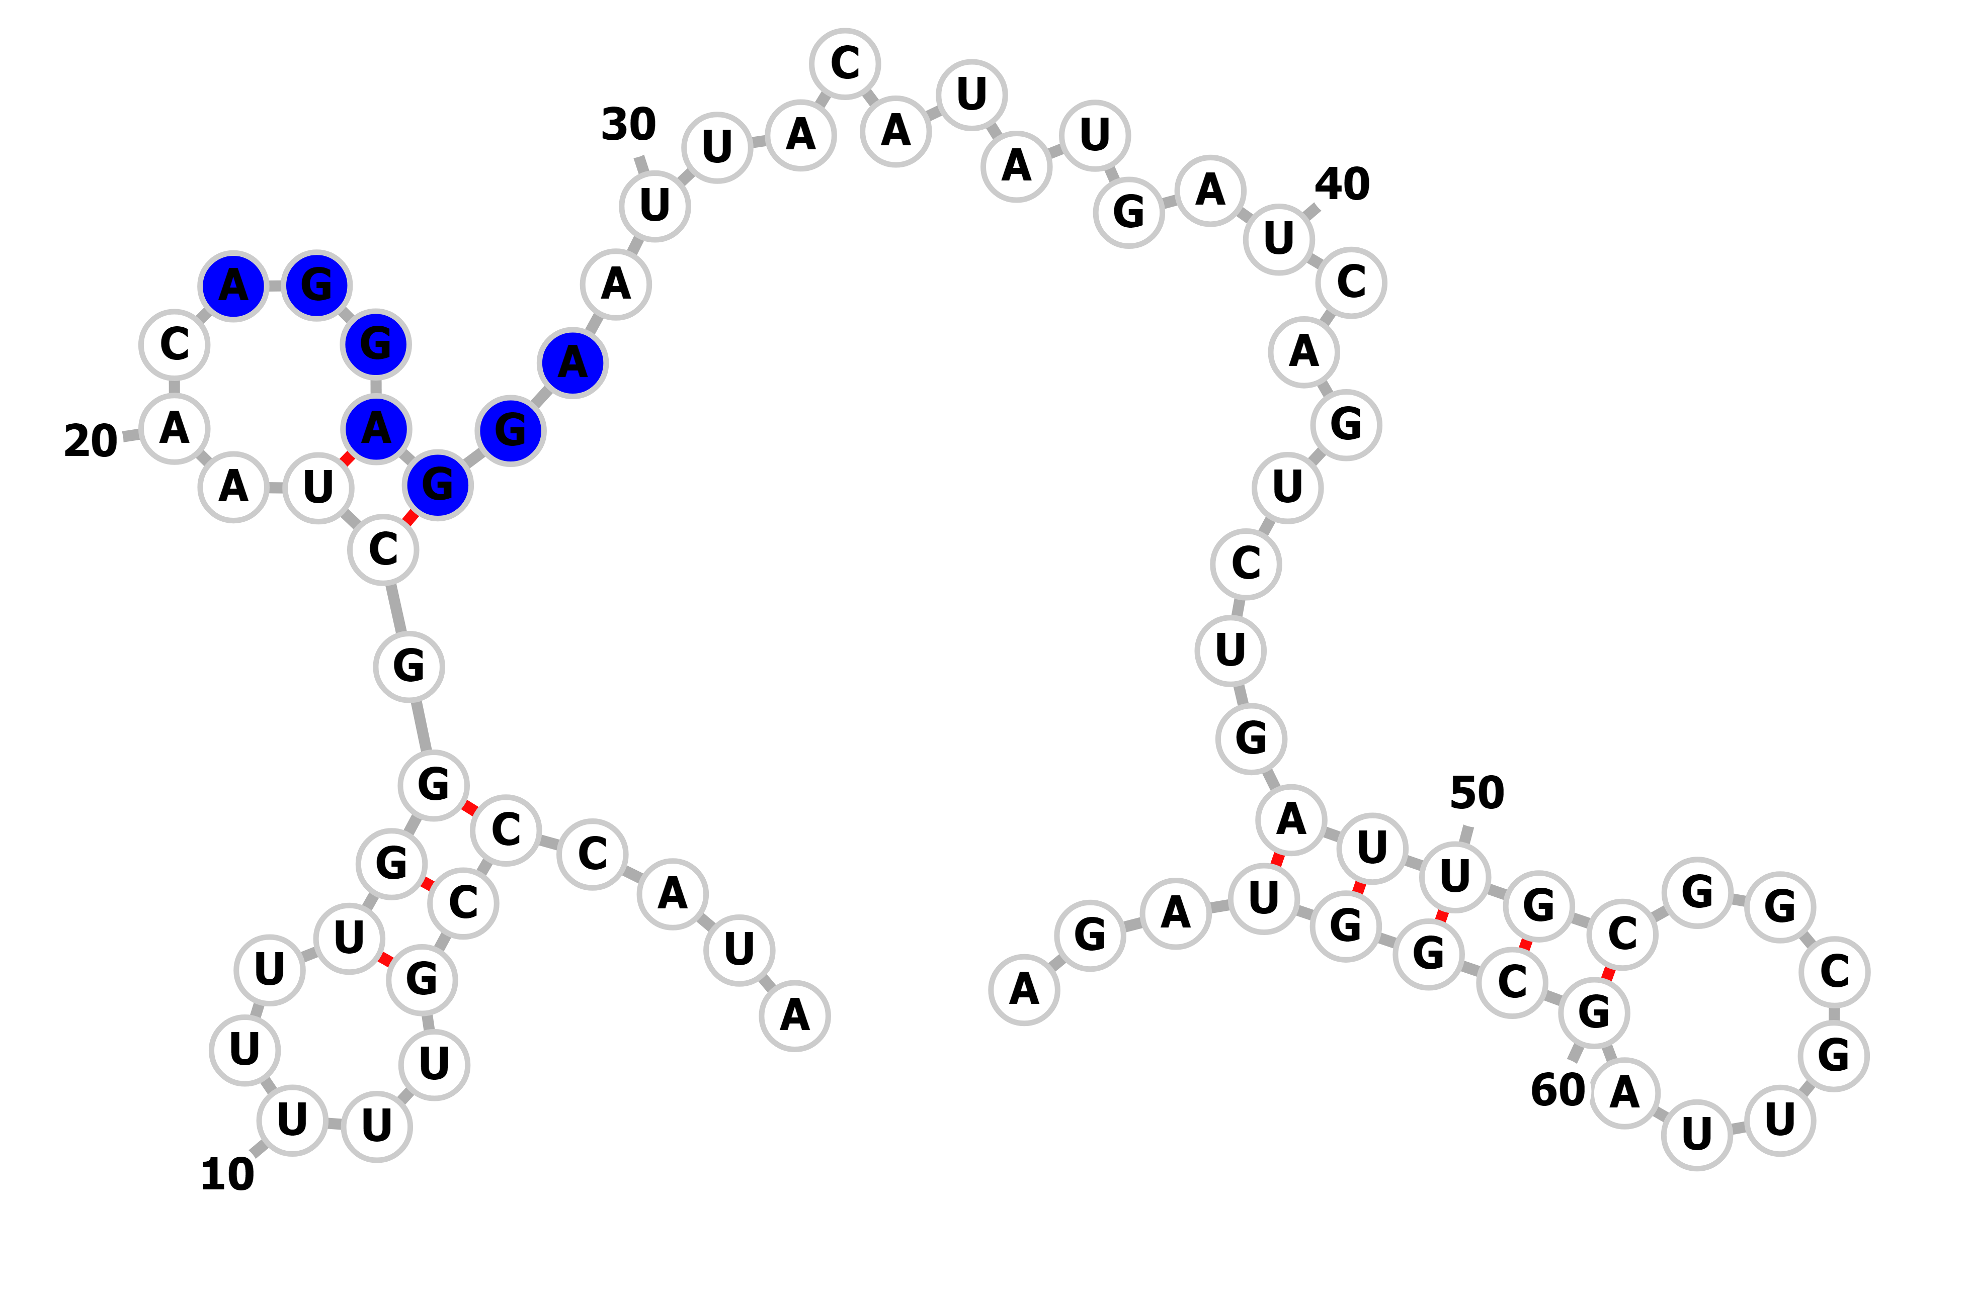
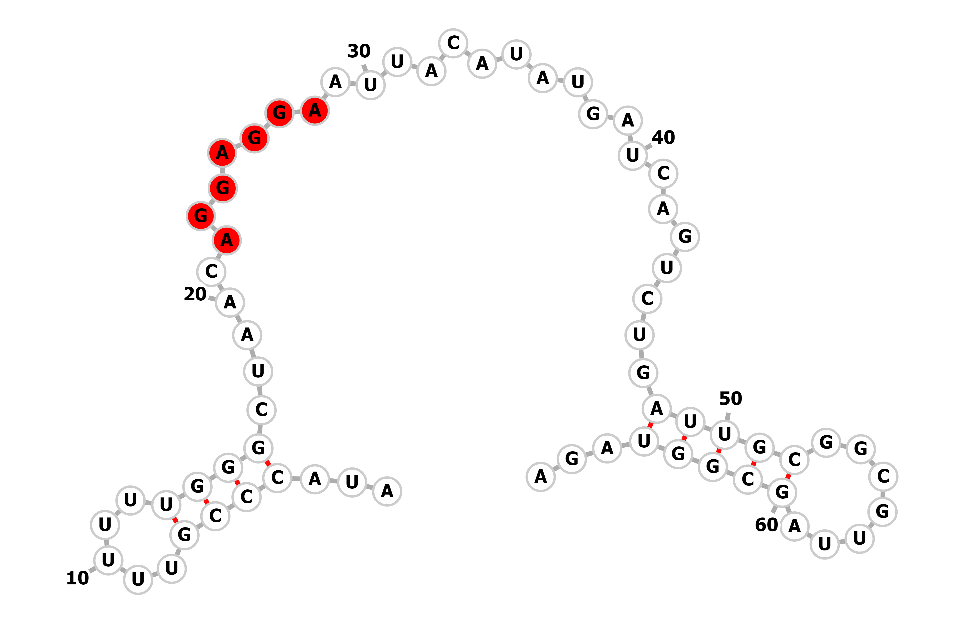
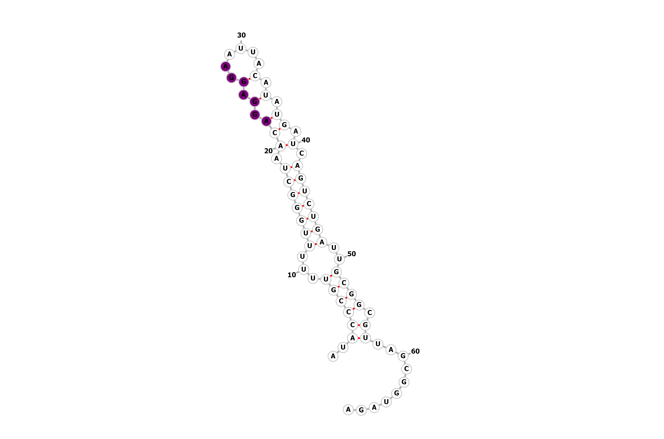
Population dynamics of structural motifs within the SD sequence
Exemplary motifs within the S-D sequence

Slide 12
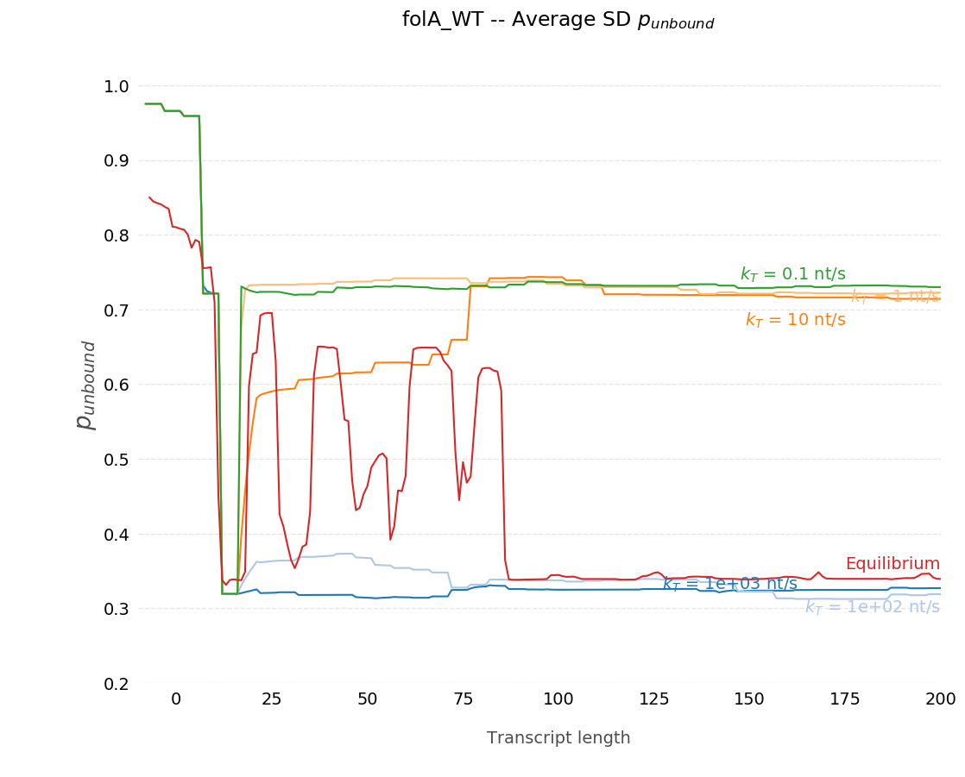
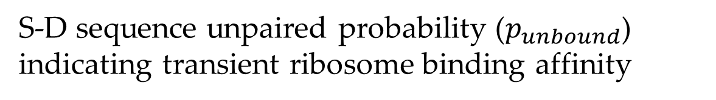
Kinetic heterogeneity during co-transcriptional folding
S-D sequence unpaired probability ($p_{unbound}$) indicating transient ribosome binding affinity
Down-stream structures act as 'allosteric modulators' on local folding stability of the SD sequence
Transcription rate alters folding pathway

Slide 13
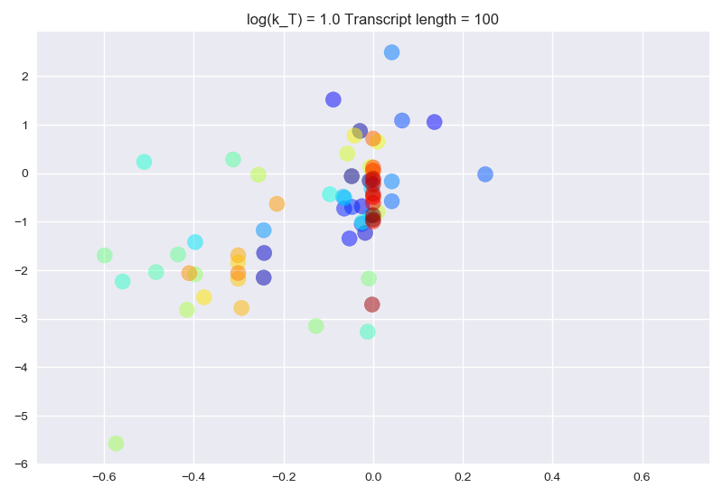
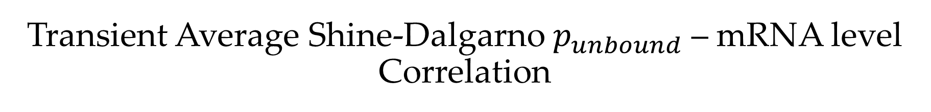
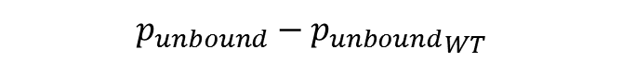
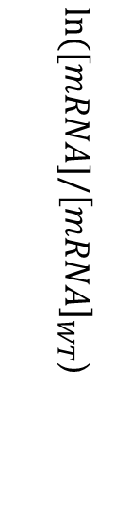
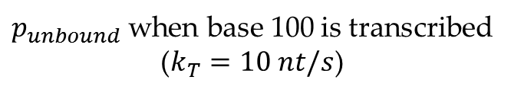
Transient Average Shine-Dalgarno $p_{unbound}$ – mRNA level Correlation
$p_{unbound}$ when base 100 is transcribed
($k_{T}=10 nt/s$)
Wild-type $p_{unbound}$ - transient RNAP position
snapshot
$ln⁡([mRNA]/{\left[mRNA\right]}_{WT}$)
$$p_{unbound}−{p_{unbound}}_{WT}$$

Slide 14
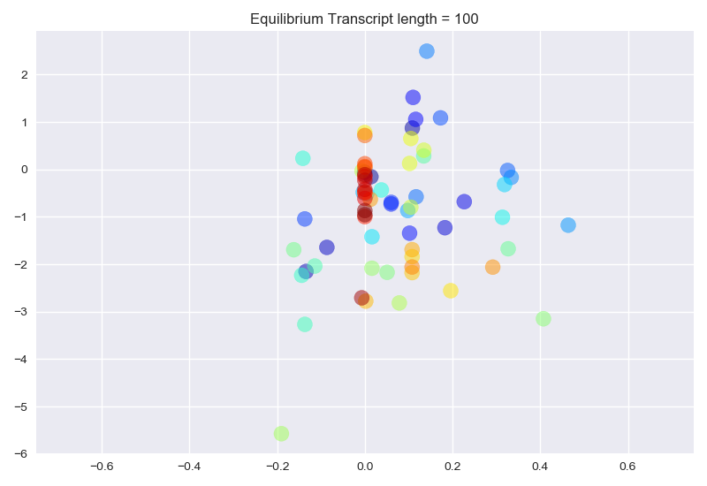
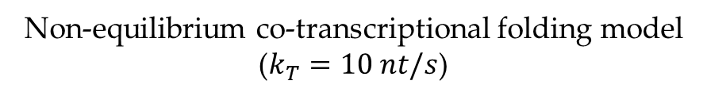
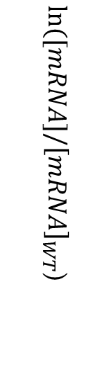
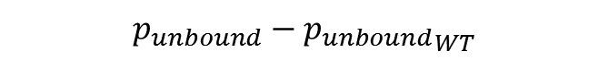
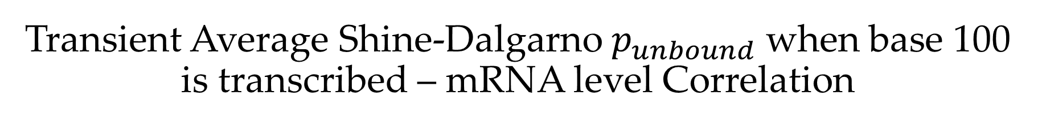
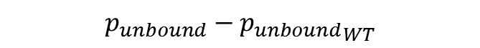
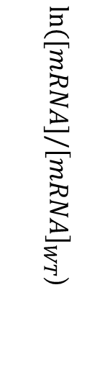
Transient Average Shine-Dalgarno $p_{unbound}$ when base 100 is transcribed – mRNA level Correlation
Control: equilibrium folding model
(infinitely slow transcription)
Non-equilibrium co-transcriptional folding model
($k_{T}=10 nt/s$)
$ln⁡([mRNA]/{\left[mRNA\right]}_{WT}$)
$ln⁡([mRNA]/{\left[mRNA\right]}_{WT}$)
R = 0.14
R = 0.57
$$p_{unbound}−{p_{unbound}}_{WT}$$
$$p_{unbound}−{p_{unbound}}_{WT}$$

Slide 15
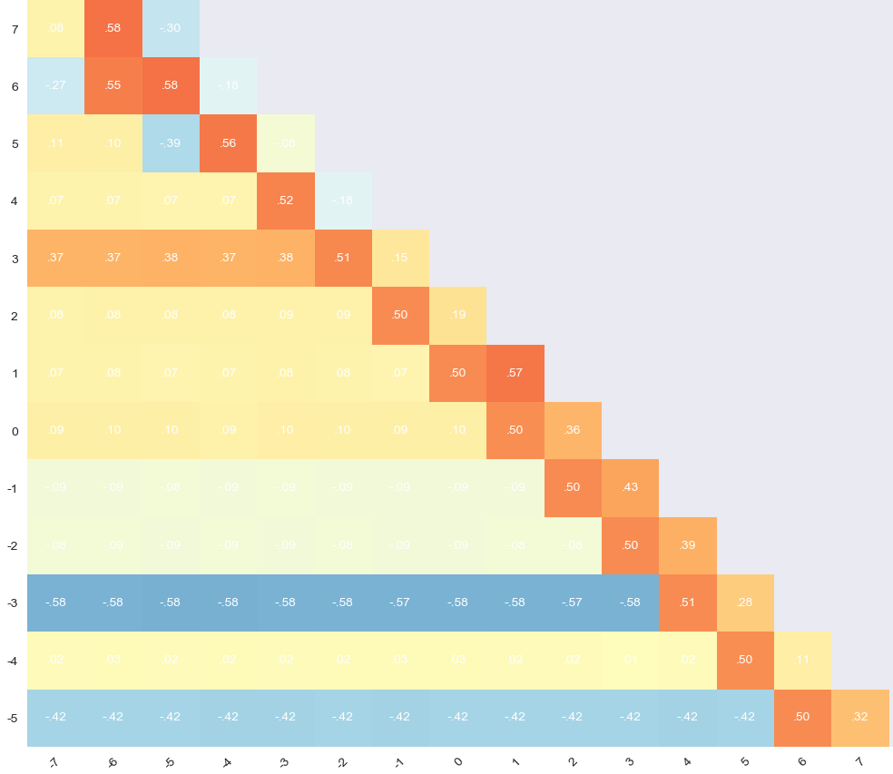
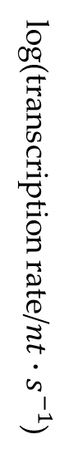
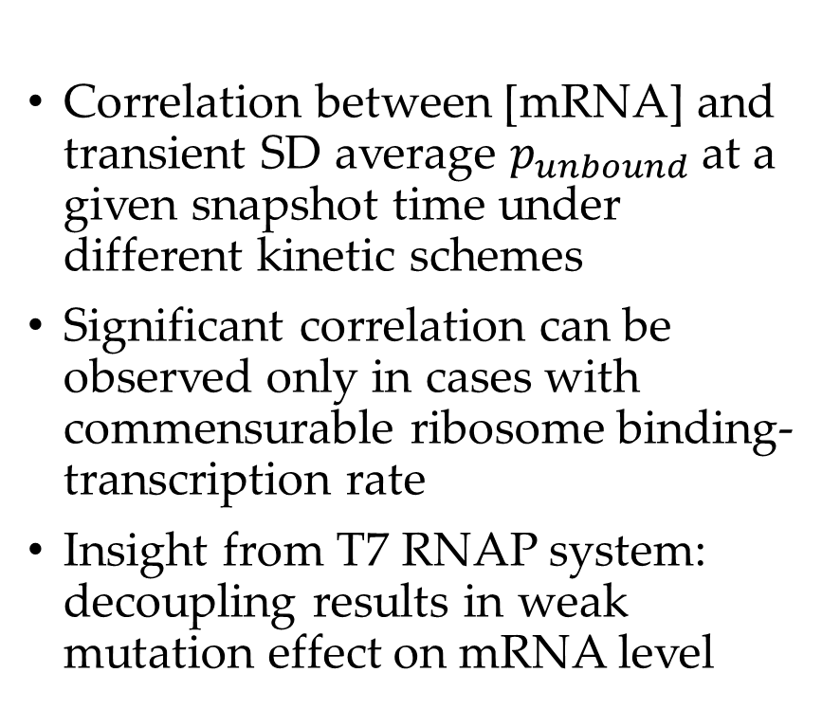
SD accessibility correlates with mRNA level variation in coupled transcription-ribosome binding schemes
Slower ribosome binding
Correlation between [mRNA] and transient SD average $p_{unbound}$ at a given snapshot time under different kinetic schemes
Significant correlation can be observed only in cases with commensurable ribosome binding-transcription rate
Insight from T7 RNAP system: decoupling results in weak mutation effect on mRNA level
log(transcription rate/$nt∙s^{−1}$)
Slower Transcription
log(snapshot time/s)

Slide 16
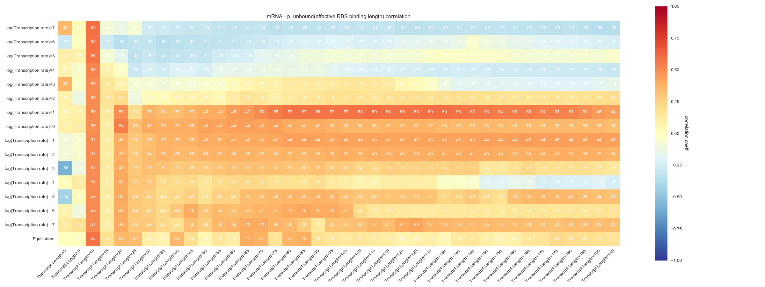
SD Ribosome binding affinity - mRNA level correlation is most significant when down-stream region is released under physiological transcription rate
10nt/s
Correlation between [mRNA] and transient $p_{unbound}\text{(}\text{SD}\text{)}$ after a given base is transcribed, for all sequences

Slide 17
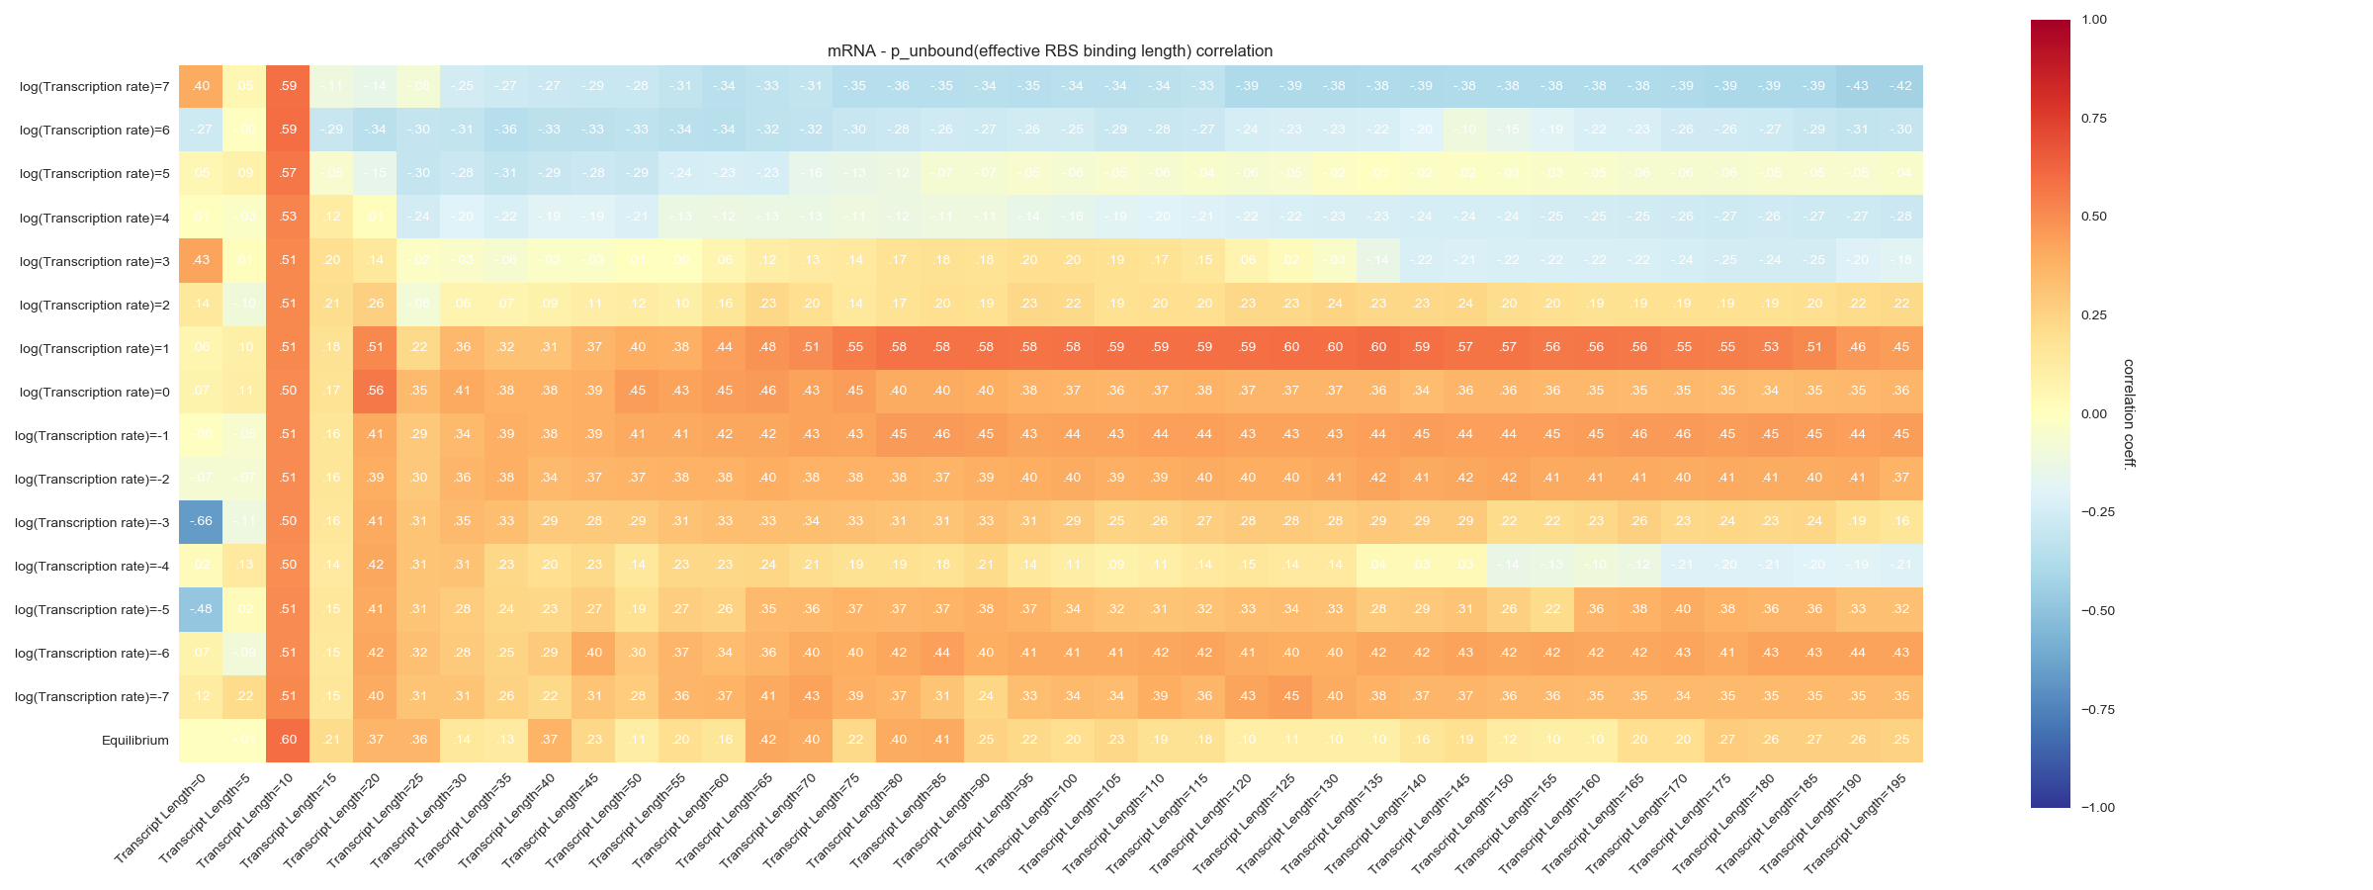
10nt/s
Same correlation test, for sequences with N-terminal mutations

Slide 18
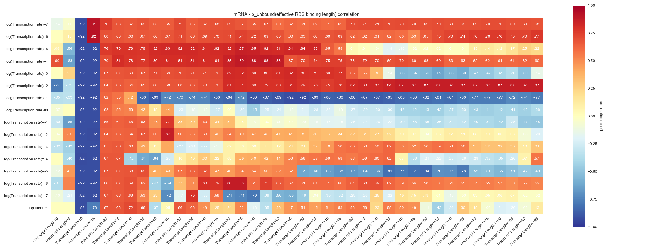
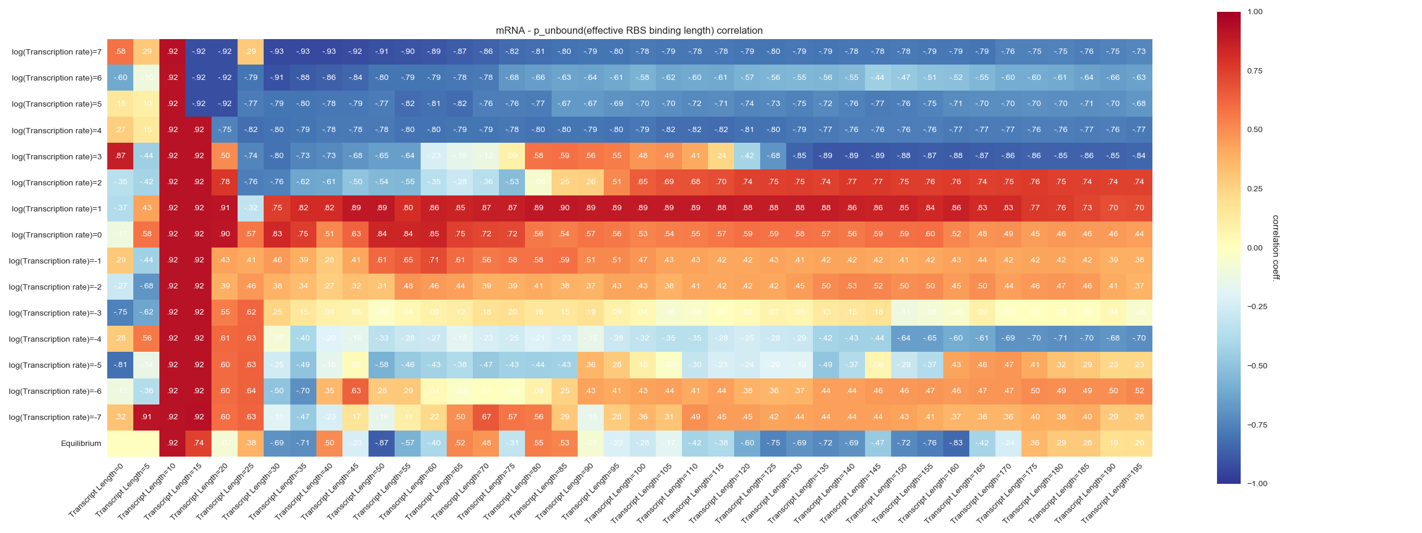
10nt/s
Same correlation test, for sequences with both N-terminal and downstream mutations

Slide 19
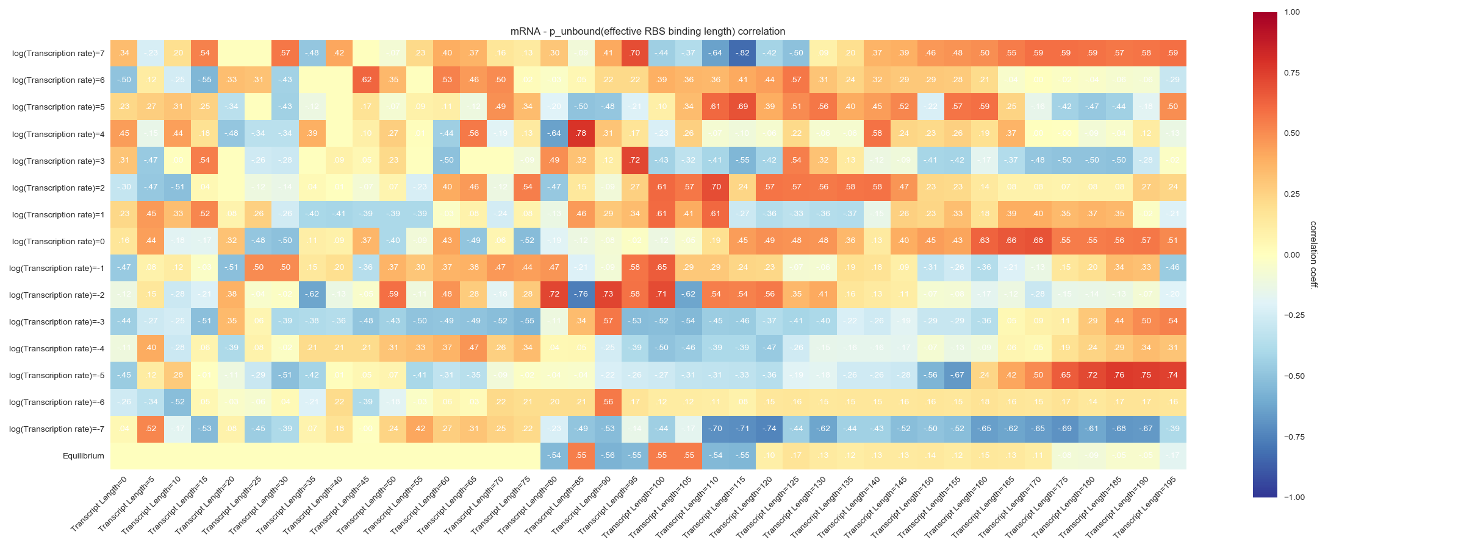
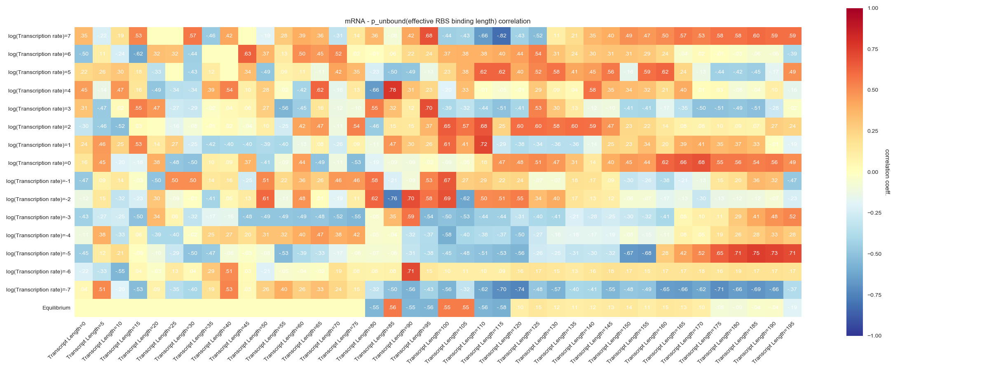
Same correlation test, for sequences with downstream mutations only

Slide 20
Future plan & Prospects
[mRNA] – transient SD unfolding free energy correlation
Develop kinetic models to address the mechanism underlying translation initiation rate – mRNA level correlation
Genome and species-wide investigation on variation of kinetic coupling and evolutionary selection pressure on codon usage

Slide 21
Acknowledgement
Prof. Eugene Shakhnovich
Dr. William Jacobs
All the group members
Thanks for your attention!

Slide 23
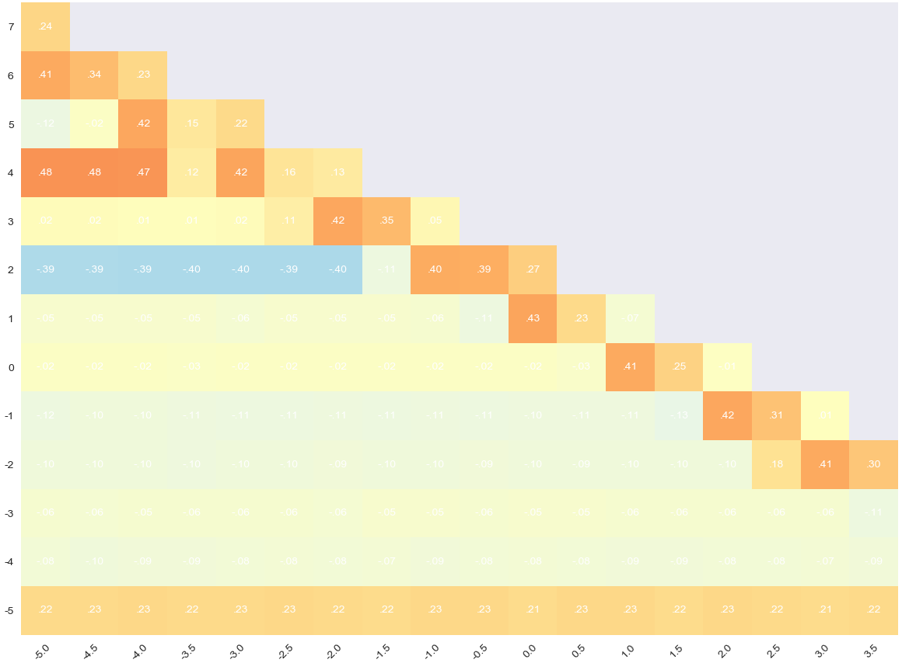
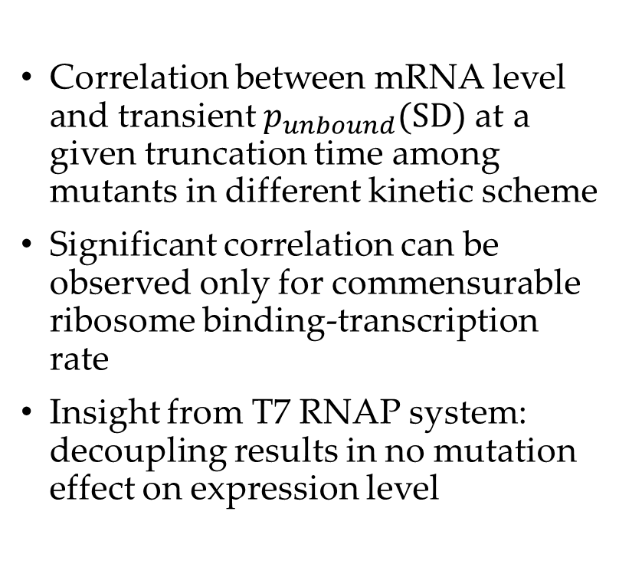
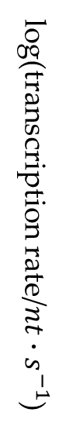
SD accessibility correlates with mRNA level variation in coupled transcription-ribosome binding schemes
Slower ribosome binding
Correlation between mRNA level and transient $p_{unbound}\text{(}\text{SD}\text{)}$ at a given truncation time among mutants in different kinetic scheme
Significant correlation can be observed only for commensurable ribosome binding-transcription rate
Insight from T7 RNAP system: decoupling results in no mutation effect on expression level
log(transcription rate/$nt∙s^{−1}$)
Slower Transcription
log(truncation time/s)

Slide 24
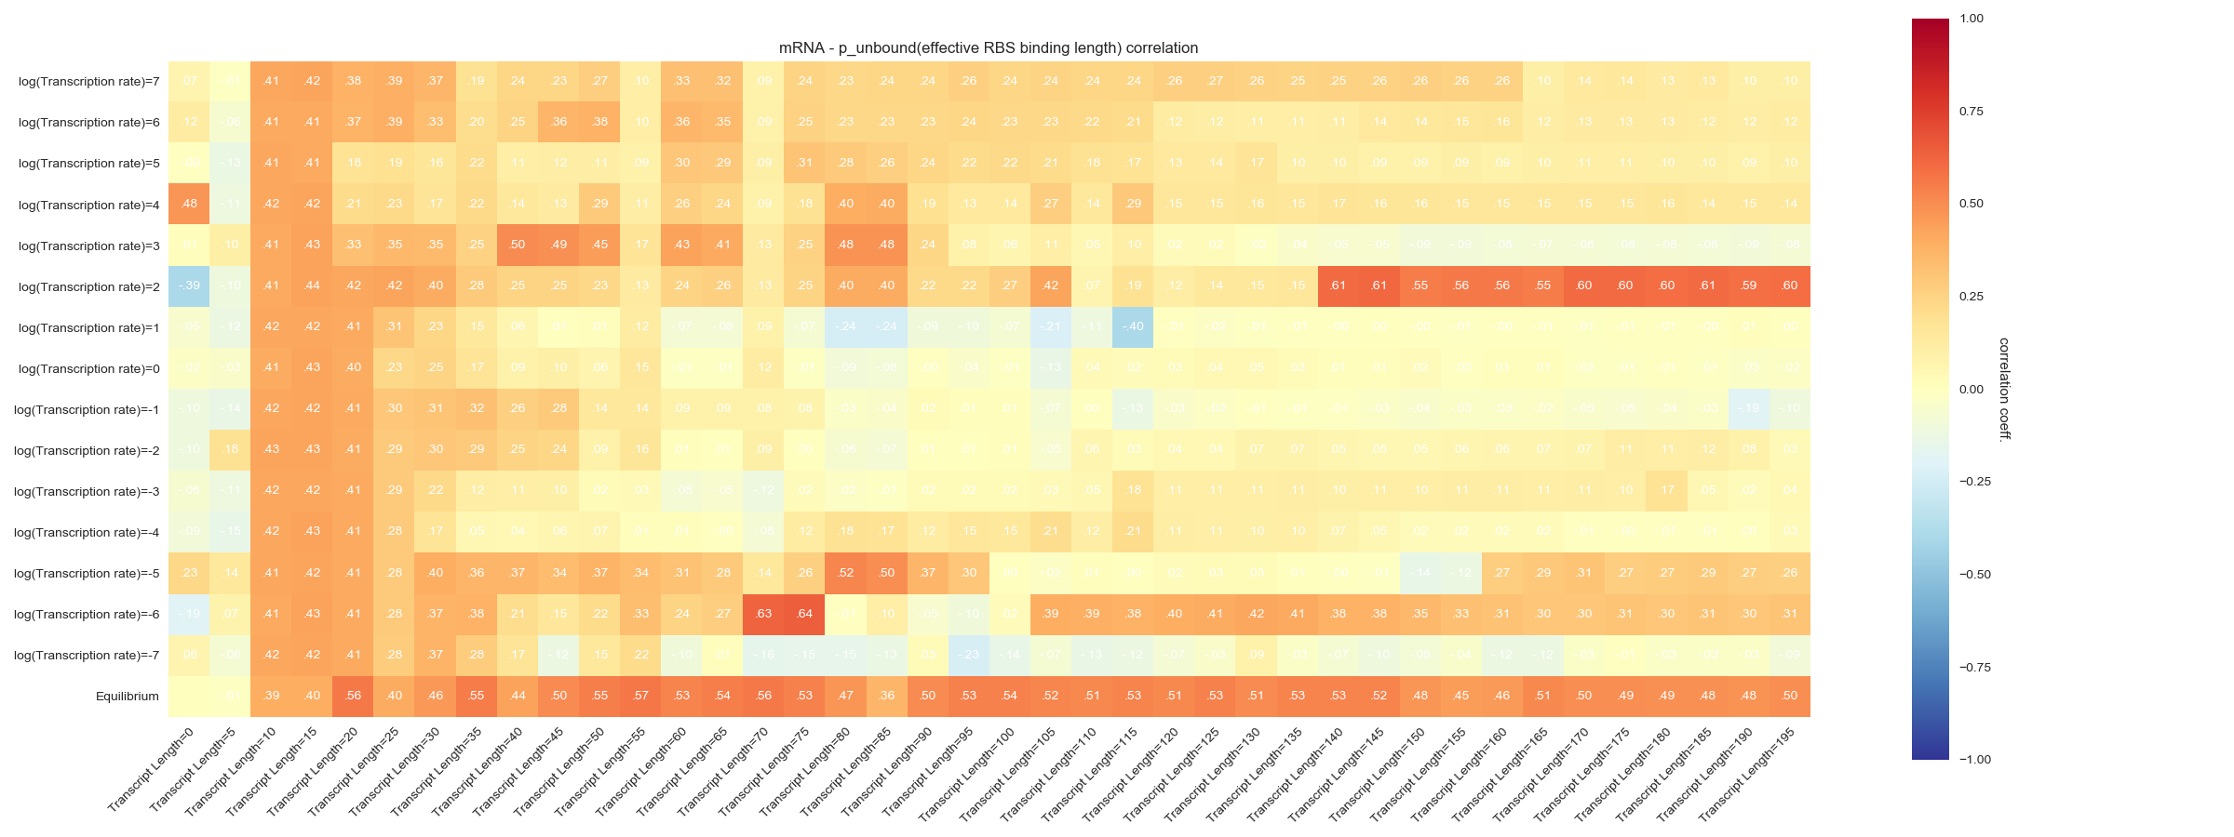
RBS binding affinity - mRNA level correlation is most significant when down-stream region is released under physiological transcription rate
Correlation between mRNA level and transient $p_{unbound}\text{(}\text{−10}\text{)}$ after a given base is transcribed, for all sequences

Slide 25
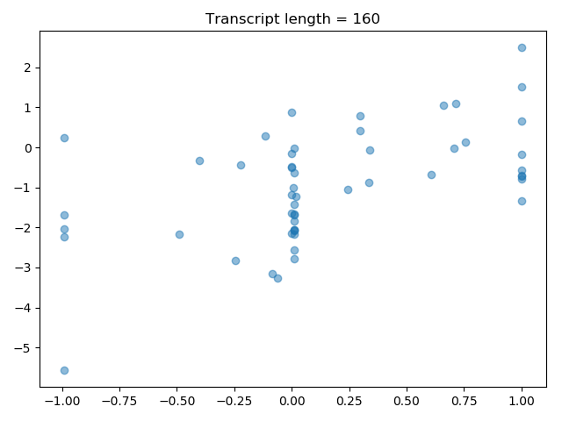

Slide 26
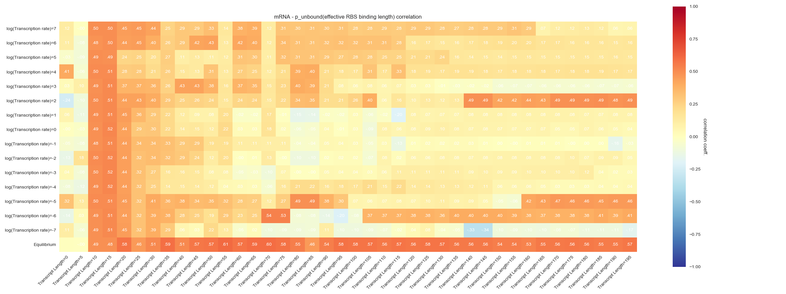
Same correlation test, for sequences only with N-terminal mutations

Slide 27
Same correlation test, for sequences with both N-terminal and downstream mutations

Slide 28

Same correlation test, for sequences with downstream mutations only

Slide 29



Biophysical scheme underlying mRNA variance: a kinetic model for coupled translation initiation
SD
Specific binding of ribosome on S-D sequence: $k_{R+}\left(t\right)$ [extractable from folding population kinetics]
Non-specific binding of termination factors: $k_{ρ}=k_{ρ}^{′}l(t)$
[Proportional to transcript length]
RNAP
Ribosome
$ρ$ factor
Transcript survival probability:
$$\frac{dP_{T}(t)}{dt}=−\left[k_{ρ}^{′}l\left(t\right)+k_{R+}\left(t\right)\right]P_{T}\left(t\right)$$
$$P_{T}(t)=exp⁡(−\frac{k_{ρ}^{′}l\left(t\right)t^{2}}{2}−{\left\langle k_{R+}\right\rangle }_{t} t)$$
Effective translation initiation rate:
$$P_{I}=\int_{0}^{∞}{dt k_{R+}\left(t\right)exp⁡(−\frac{k_{ρ}^{′}l\left(t\right)t^{2}}{2}−{\left\langle k_{R+}\right\rangle }_{t} t) }$$

